Slide 1
R.K.Tiwary

Slide 2
CPU Structure
CPU must:
Fetch Opcode
Interpret instructions (decode)
Fetch data (if needed)
Process data
Write data

Slide 3
Prefetch
Fetch accessing main memory
Execution usually does not access main memory
Can fetch next instruction during execution of current instruction Called instruction prefetch
Improved Performance
But not doubled:
Fetch usually shorter than execution
Prefetch more than one instruction?
Any jump or branch means that prefetched instructions are not the required instructions
Add more stages to improve performance

Slide 4
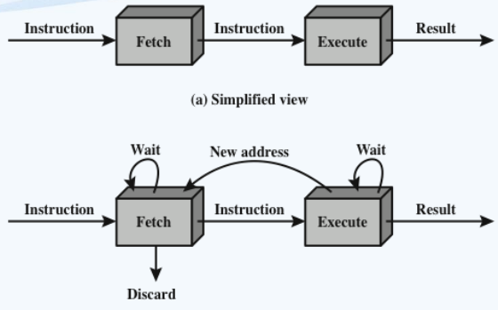
Two-Stage Instruction Pipeline
The pipeline has two independent stages. The first stage fetches an instruction and buffers it.
When the second stage is free, the first stage passes it the buffered instruction.
While the second stage is executing the instruction, the first stage takes advantage of any unused memory cycles to fetch and buffer the next instruction.
This is called instruction prefetch or fetch overlap.
Expanded View

Slide 5
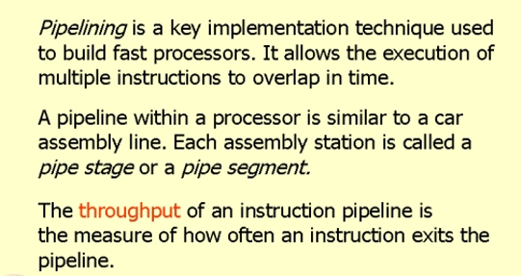
Pipelining

Slide 6
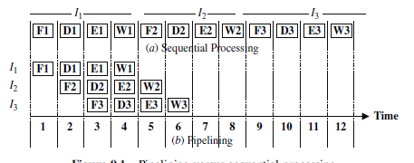
Pipelining versus sequential processing

Slide 7
performance measures for the goodness
of a pipeline
Speed-up S(n)
Throughput U(n)
Efficiency E(n)

Slide 8
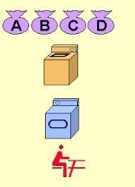
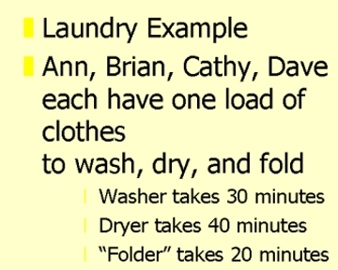
Pipelining : Its Natural

Slide 9
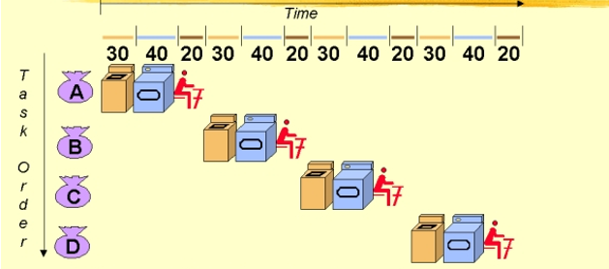
Sequential Laundary
Total Time taken= 6Hrs

Slide 10
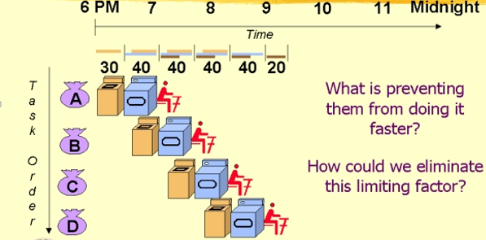
Pipelined Laundry Start Work ASAP
Takes only 3.5 Hrs

Slide 11
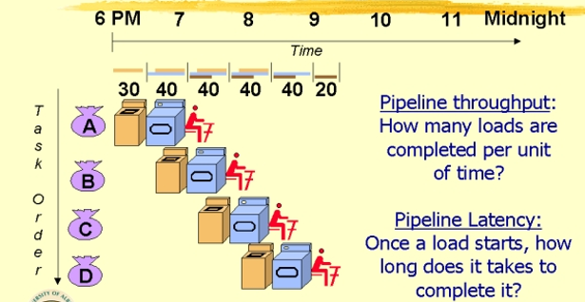
Pipelined Laundry Start Work ASAP

Slide 12
Additional Stages
Fetch operands (FO)
Fetch each operand from memory
Operands in registers need not be fetched
Execute instruction (EI)
Perform the indicated operation and store the result, if any, in the specified destination operand location
Write operand or write Back (WO/WB)
Store the result in memory
■ Fetch instruction (FI)
Read the next expected instruction into a buffer
Decode instruction (DI)
Determine the opcode and the operand specifiers
Calculate operands (CO)
Calculate the effective address of each source operand
This may involve displacement, register indirect, indirect, or other forms of address calculation

Slide 13
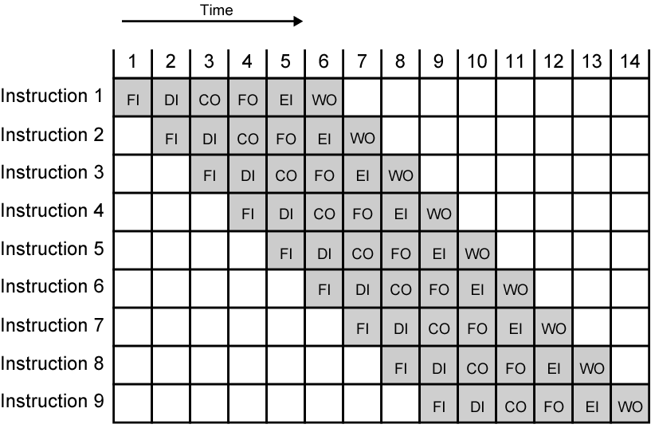
Timing Diagram for Instruction Pipeline Operation

Slide 14
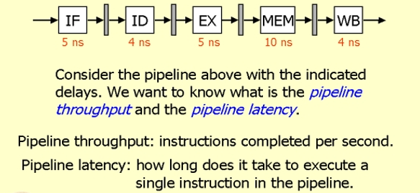
Pipeline Throughput and Latency

Slide 15
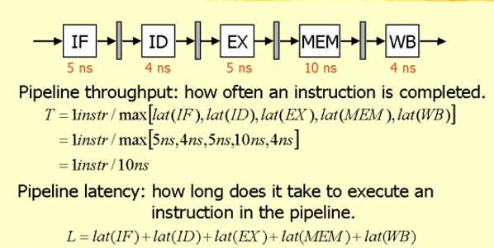
Pipeline Throughput and Latency

Slide 16
Pipeline Throughput and Latency
= 5ns+ 4ns+5ns+10ns+4ns= 28ns
Is it correct?

Slide 17
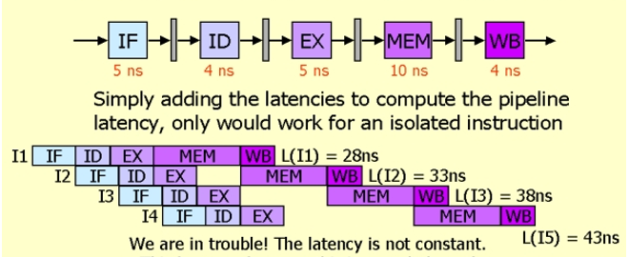
Pipeline Throughput and Latency

Slide 18
Pipeline Throughput and Latency
This is an unbalanced pipeline
Solution
Make every state the same length
Longest

Slide 19
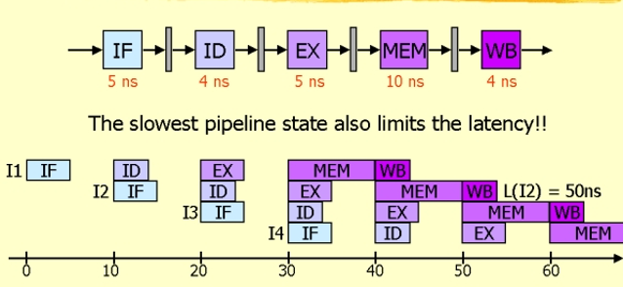
Pipeline Throughput and Latency

Slide 20
Pipeline Throughput and Latency
L(I₁)= L(I₂)= L(I₃)= L(I₄)= 50

Slide 21
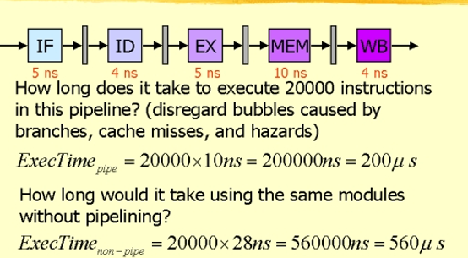
Pipeline Throughput and Latency

Slide 22

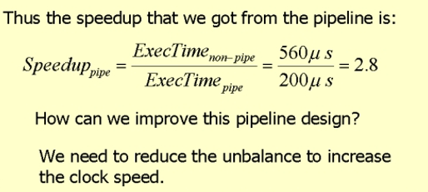
Pipeline Throughput and Latency

Slide 23

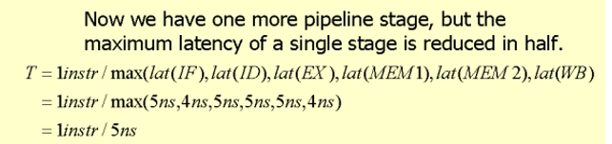
Pipeline Throughput and Latency

Slide 24
Pipeline Throughput and Latency
The latency of a single Instruction is
L= 6 X 5ns= 30ns

Slide 25
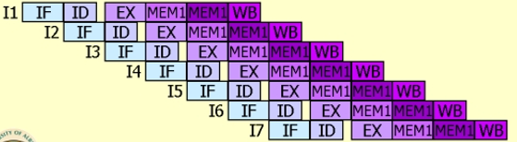
Pipeline Throughput and Latency

Slide 26



Speed-up S(n)
Consider the execution of m tasks (instructions) using
n-stages (units) pipeline. As can be seen, n + m - 1 time units are required to complete m tasks.
Speed-up S(n) =
(i:e: n-fold increase in speed is
theoretically possible)

Slide 27
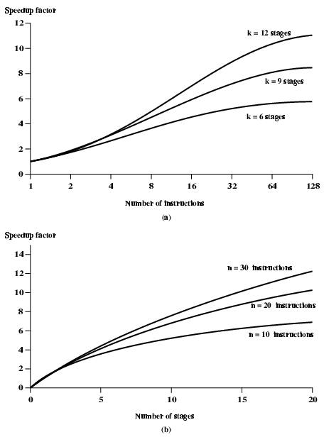
Speed-up S(n)
the larger the number of pipeline stages, the greater the potential for speedup.
However, as a practical matter, the potential gains of additional pipeline stages are countered by increases in cost, delays between stages, and the fact that branches will be encountered requiring the flushing of the pipeline

Slide 28
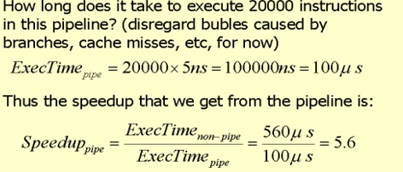
Pipeline Throughput and Latency
Throughput U(n)

Slide 29
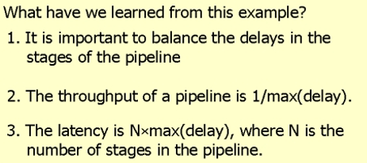
Pipeline Throughput and Latency
Throughput U(n)

Slide 30
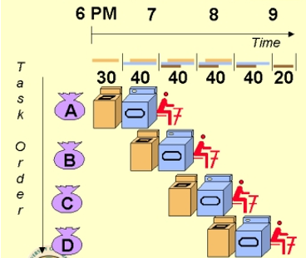
Traditional Pipeline Concept
Pipelining doesn’t help latency of single task, it helps throughput of entire workload
Pipeline rate limited by slowest pipeline stage
Multiple tasks operating simultaneously using different resources
Potential speedup = Number pipe stages
Unbalanced lengths of pipe stages reduces speedup
Time to “fill” pipeline and time to “drain” it reduces speedup
Stall for Dependences

Slide 31
Role of Cache Memory
Each pipeline stage is expected to complete in one clock cycle.
The clock period should be long enough to let the slowest pipeline stage to complete.
Faster stages can only wait for the slowest one to complete.
Since main memory is very slow compared to the execution, if each instruction needs to be fetched from main memory, pipeline is almost useless.
Fortunately, we have cache.

Slide 32
Pipeline Hazards
Pipeline, or some portion of pipeline, must stall
Also called pipeline bubble
Types of hazards
Resource
Data
Control

Slide 33
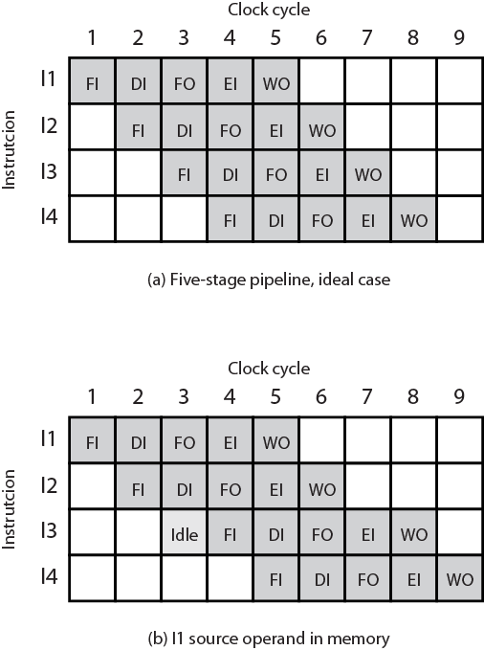
Resource Hazard Diagram
A resource hazard occurs when two or more instructions that are already in the pipeline need the same resource
The result is that the instructions must be executed in serial rather than parallel for a portion of the pipeline
A resource hazard is sometimes referred to as a structural hazard

Slide 34
Resource Hazards
Two (or more) instructions in pipeline need same resource
Executed in serial rather than parallel for part of pipeline
E.g. Assume simplified five-stage pipeline: Each stage takes one clock cycle
Ideal case is new instruction enters pipeline each clock cycle
Assume main memory has single port
Assume instruction fetches and data reads and writes performed one at a time
Ignore the cache
Operand read or write cannot be performed in parallel with instruction fetch
Fetch instruction stage must idle for one cycle fetching I3
E.g. multiple instructions ready to enter execute instruction phase
Single ALU
One solution: increase available resources
Multiple main memory ports
Multiple ALUs

Slide 35
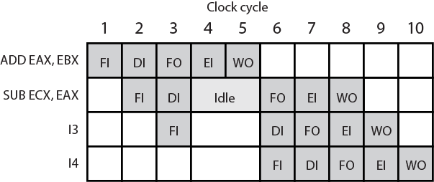
Data Hazard Diagram : RAW hazard
Data Hazards : A data hazard occurs when there is a conflict in the access of an operand location

Slide 36
Types of Data Hazard
Read after write (RAW), or true dependency
An instruction modifies a register or memory location
Succeeding instruction reads data in memory or register location
Hazard occurs if the read takes place before write operation is complete
Write after read (WAR), or anti-dependency
An instruction reads a register or memory location
Succeeding instruction writes to the location
Hazard occurs if the write operation completes before the read operation takes place
Write after write (WAW), or output dependency
Two instructions both write to the same location
Hazard occurs if the write operations take place in the reverse order of the intended sequence

Slide 37
Data Hazards
Conflict in access of an operand location
Two instructions to be executed in sequence
Both access a particular memory or register operand
If in strict sequence, no problem occurs
If in a pipeline, operand value could be updated so as to produce different result from strict sequential execution
E.g. x86 machine instruction sequence:
ADD EAX, EBX /* EAX = EAX + EBX
SUB ECX, EAX /* ECX = ECX – EAX
ADD instruction does not update EAX until end of stage 5, at clock cycle 5
SUB instruction needs value at beginning of its stage 2, at clock cycle 4
Pipeline must stall for two clocks cycles
Without special hardware and specific avoidance algorithms, results in inefficient pipeline usage

Slide 38
Control Hazard
Also known as a branch hazard
Occurs when the pipeline makes the wrong decision on a branch prediction
Brings instructions into the pipeline that must subsequently be discarded
Dealing with Branches:
Multiple streams
Prefetch branch target
Loop buffer
Branch prediction
Delayed branch

Slide 39
Multiple Streams
A simple pipeline suffers a penalty for a branch instruction because it must choose one of two instructions to fetch next and may make the wrong choice
A brute-force approach is to replicate the initial portions of the pipeline and allow the pipeline to fetch both instructions, making use of two streams
Drawbacks:
• With multiple pipelines there are contention delays for access to the registers and to memory
• Additional branch instructions may enter the pipeline before the original branch decision is resolved
Despite these drawbacks, this strategy can improve performance. Examples of machines with two or more pipeline streams are the IBM 370/168 and the IBM 3033

Slide 40
Prefetch Branch Target
When a conditional branch is recognized, the target of the branch is prefetched, in addition to the instruction following the branch
Target is then saved until the branch instruction is executed
If the branch is taken, the target has already been prefetched
IBM 360/91 uses this approach

Slide 41
Loop Buffer
Small, very-high speed memory maintained by the instruction fetch stage of the pipeline and containing the n most recently fetched instructions, in sequence
Benefits:
Instructions fetched in sequence will be available without the usual memory access time
If a branch occurs to a target just a few locations ahead of the address of the branch instruction, the target will already be in the buffer
This strategy is particularly well suited to dealing with loops
Similar in principle to a cache dedicated to instructions
Differences:
The loop buffer only retains instructions in sequence
Is much smaller in size and hence lower in cost

Slide 42
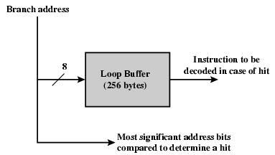
Loop Buffer Diagram
least significant
The remaining most significant bits are checked to determine if the branch target lies within the environment captured by the buffer

Slide 43
Branch Prediction
Various techniques can be used to predict whether a branch will be taken:
1. Predict never taken | These approaches are static They do not depend on the execution history up to the time of the conditional branch instruction
2. Predict always taken
3. Predict by opcode
Taken/not taken switch | These approaches are dynamic They depend on the execution history
Taken/not taken switch

Slide 44
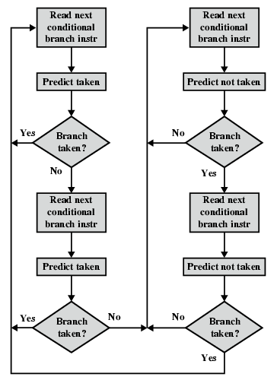
Branch Prediction Flowchart
With a single bit, all that can be recorded is whether the last execution of this instruction resulted in a branch or not
. A shortcoming of using a single bit appears in the case of a conditional branch instruction that is almost always taken, such as a loop instruction. With only one bit of history, an error in prediction will occur twice for each use of the loop: once on entering the loop, and once on exiting.
If two bits are used, they can be used to record the result of the last two instances of the execution of the associated instruction

Slide 45
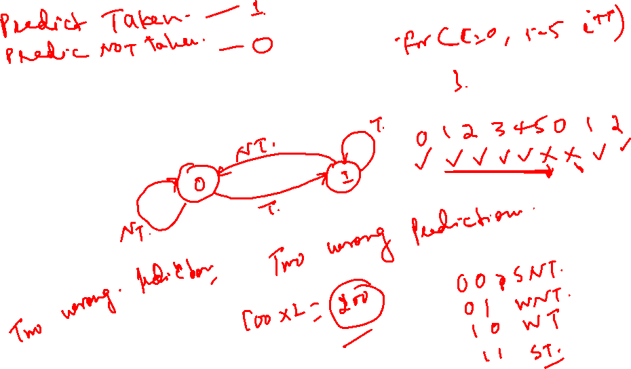

Slide 46
Dynamic Branch Prediction
Why does prediction work?
Underlying algorithm has regularities
Data that is being operated on has regularities
Instruction sequence has redundancies that are artifacts of way that humans/compilers think about problems
Is dynamic branch prediction better than static branch prediction?
Seems to be
There are a small number of important branches in programs which have dynamic behavior

Slide 47
Dynamic Branch Prediction
Performance = ƒ(accuracy, cost of misprediction)
Branch History Table(BHT): Lower bits of PC address index table of 1-bit values
Says whether or not branch taken last time
No address check
Problem: in a loop, 1-bit BHT will cause two mispredictions (avg is 9 iterations before exit):
End of loop case, when it exits instead of looping as before
First time through loop on next time through code, when it predicts exit instead of looping

Slide 48
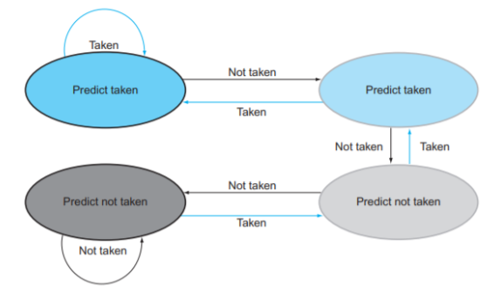
Dynamic Branch Prediction
Solution: 2-bit scheme where change prediction only if get misprediction twice

Slide 49
Branch Prediction State Diagram

Slide 50
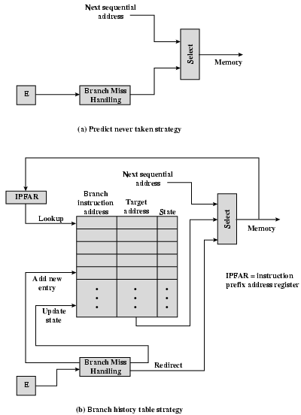
Dealing With Branches
The branch history table is a small cache memory associated with the instruction fetch stage of the pipeline.
Each entry in the table consists of three elements:
the address of a branch instruction,
some number of history bits that record the state of use of that instruction,
and information about the target instruction
If a branch is taken, some logic in the processor detects this and instructs that the next instruction be fetched from the target address (in addition to flushing the pipeline)
The branch history table is treated as a cache.
Each prefetch triggers a lookup in the branch history table. If no match is found, the next sequential address is used for the fetch. If a match is found, a prediction is made based on the state of the instruction:
Either the next sequential address or the branch target address is fed to the select logic.

Slide 51
Intel 80486 Pipelining
Fetch
From cache or external memory
Put in one of two 16-byte prefetch buffers
Fill buffer with new data as soon as old data consumed
Average 5 instructions fetched per load
Independent of other stages to keep buffers full
Decode stage 1
Opcode & address-mode info
At most first 3 bytes of instruction
Can direct D2 stage to get rest of instruction
Decode stage 2
Expand opcode into control signals
Computation of complex address modes
Execute
ALU operations, cache access, register update
Writeback
Update registers & flags
Results sent to cache & bus interface write buffers

Slide 52
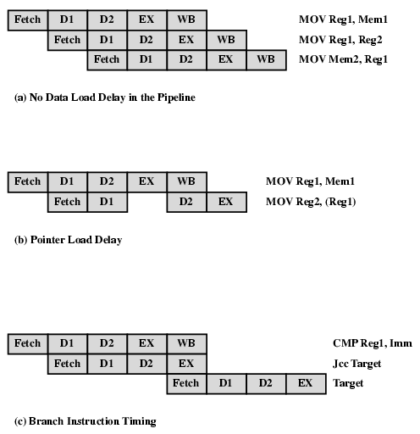
80486 Instruction Pipeline Examples

Slide 53
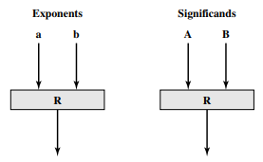
Pipelining Example
Pipelining can be applied within the ALU to speed up floating-point operations. Consider the case of floating-point addition and subtraction. In simplified terms, the pipeline could have four stages:
(1) Compare the exponents;
(2) Choose the exponent and align the significands;
(3) Add or subtract significands;
(4) Normalize the results.
The pipeline can be considered to have two parallel threads, one handling exponents and one handling significands, and could start out like this:
In this figure, the boxes labeled R refer to a set of registers used to hold temporary results. Complete the block diagram that shows at a top level the structure of the pipeline

Slide 54
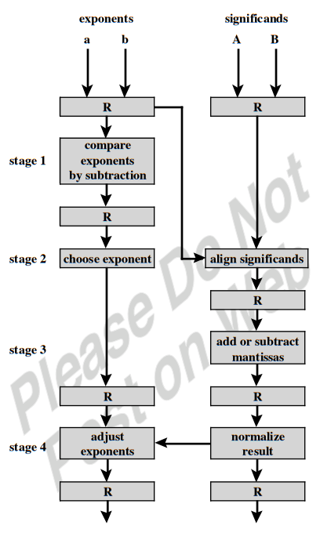
Pipelining Example
The pipeline can be considered to have two parallel threads, one handling exponents and one handling significands, and could start out like this:

Slide 55
In class exercise
Given a deeply pipelined processor and a branch-target buffer for conditional branches only, assuming a misprediction penalty of 4 cycles and a buffer miss penalty of 3 cycles, 90% hit rate and 90% accuracy, and 15% branch frequency. How much faster is the processor with the BTB vs. a processor that has a fixed 2-cycle branch penalty?
Speedup = CPI_{noBTB} /CPI_{BTB}
= (CPI_{base} + Stalls_{noBTB} )/(CPI_{base} + Stalls_{BTB} )
Stalls = ∑ Frequency x Penalty
Stalls_{noBTB} = 15% x 2 = 0.30
Stalls_{BTB} = Stalls_{miss-BTB} + Stalls_{hit-BTB-correct} + Stalls_{hit-BTB-wrong}
= 15%x10%x3 + 15%x90%x90%x0 +15%x90%x10%x4
= 0.097
Speedup = (1 + 0.3) / (1 + 0.097) = 1.2

Slide 56
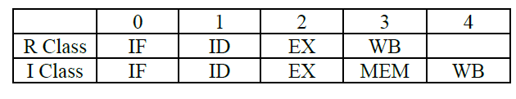
Example 1
1. Consider a machine which supports the following two instruction schedules for R class and I class instructions. Assume an instruction mix of 60% R class and 40% I class instructions. Assume that IF steps take 25 nanoseconds, MEM steps of instruction execution require 45 nanoseconds and the other steps require 20 nanoseconds.
For a multi-cycle implementation,
What is the minimum clock cycle time?
How long does it take to execute 100 instructions in nanoseconds?

Slide 57
Example 1 Sol
For a multi-cycle implementation, clock cycle time is the time for the longest stage => 45 ns
2. For a multi-cycle implementation,
exec_time = 100 x (exec_time R + exec_time I )
= 100 x (cycle time x CPI x IC) R + (cycle time x CPI x IC) I
= 100 x (4 x 45 x 0.6 + 5 x 45 x 0.4)
= 19800ns

Slide 58
Example 2
Eg. Consider an un-pipelined processor. Assume that it has 1-ns clock cycle and that it uses 4 cycles for ALU operations and 5 cycles for branches and 4 cycles for memory operations.
Assume that the relative frequencies of these operations are 50%, 35% and 15% respectively. Suppose that due to clock skew and set up, pipelining the processor adds 0.15 ns of overhead to the clock. Ignoring any latency impact, how much speed up in the instruction execution rate will we gain from a pipeline?
The average instruction execution time on an un-pipelined processor is
= clock cycle × Avg. CPI
= 1 ns × ((0.5 × 4) + (0.35 × 5) + (0.15 × 4))
= 4.35 ns
The avg. instruction execution time on pipelined processor is = 1 ns + 0.2 ns = 1.2 ns
So speed up = 4.35/1.2 = 3.3625

Slide 59
Speed Up Equation for Pipelining
For simple RISC pipeline, Ideal CPI = 1:

Slide 60
Example: Dual-port vs. Single-port
Machine A: Dual ported memory (“Harvard Architecture”)
Machine B: Single ported memory, but its pipelined implementation has a 1.05 times faster clock rate
Ideal CPI = 1 for both
Loads are 40% of instructions executed
SpeedUp_{A} = Pipeline Depth/(1 + 0) x (clock_{unpipe}/clock_{pipe})
= Pipeline Depth
SpeedUp_{B} = Pipeline Depth/(1 + 0.4 x 1) x (clock_{unpipe}/(clock_{unpipe} / 1.05)
= (Pipeline Depth/1.4) x 1.05
= 0.75 x Pipeline Depth
SpeedUp_{A} / SpeedUp_{B} = Pipeline Depth/(0.75 x Pipeline Depth) = 1.33
Machine A is 1.33 times faster

Slide 61
Evaluating Branch Alternatives
Assume 4% unconditional branch, 6% conditional branch- untaken, 10% conditional branch-taken; Deeper pipeline: target & condition known @ end of 3rd & 4th stage respectively
What’s the addition to CPI?
Scheduling Uncond Untaken Taken.
scheme penalty penalty penalty
Stall pipeline 2 3 3
Predict taken 2 3 2
Predict not taken 2 0 3
Scheduling Uncond Untaken Taken All branches
scheme branches branches branches
4% 6% 10% 20%
Stall pipeline 0.08 0.18 0.3 0.56
Predict taken 0.08 0.18 0.2 0.46
Predict not taken 0.08 0.00 0.3 0.38

Slide 62
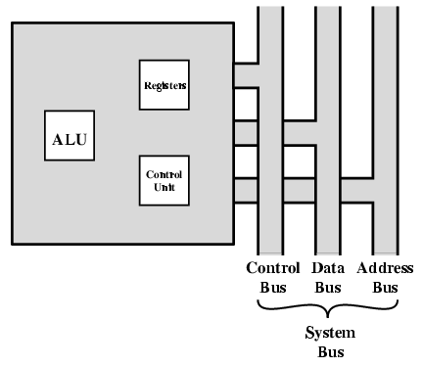
CPU With Systems Bus
major components : arithmetic and logic unit (ALU) and a control unit (CU)
a minimal internal memory, consisting of a set of storage locations, called registers.

Slide 63
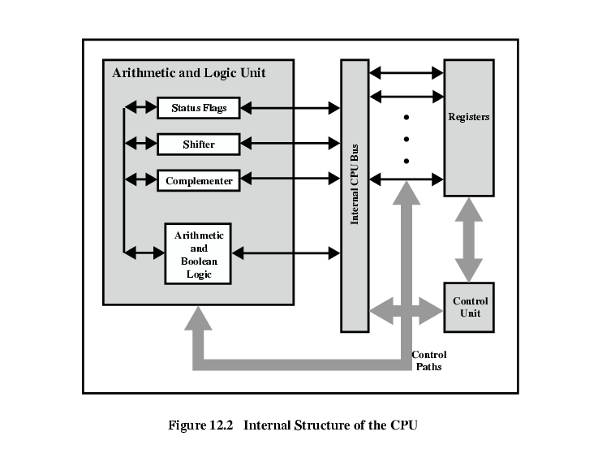
CPU Internal Structure
similarity between the internal structure of the computer as a whole and the internal structure of the processor.
In both cases, there is a small collection of major elements (computer: processor, I/O, memory; processor: control unit, ALU, registers) connected by data paths.

Slide 64
Registers
CPU must have some working space (temporary storage)
Called registers
Number and function vary between processor designs
One of the major design decisions
Top level of memory hierarchy
The registers in the processor perform two roles
User-Visible Registers | Control and Status Registers
Enable the machine or assembly language programmer to minimize main memory references by optimizing use of registers | Used by the control unit to control the operation of the processor and by privileged operating system programs to control the execution of programs

Slide 65
User-Visible Registers
Categories:
General purpose
Can be assigned to a variety of functions by the programmer
Data
May be used only to hold data and cannot be employed in the calculation of an operand address
Address
May be somewhat general purpose or may be devoted to a particular addressing mode
Examples: segment pointers, index registers, stack pointer
Condition codes
Also referred to as flags
Bits set by the processor hardware as the result of operation
Referenced by means of the machine language that the processor executes

Slide 66
User-Visible Registers
General-purpose registers can be assigned to a variety of functions by the programmer. Sometimes their use within the instruction set is orthogonal to the operation. That is, any general-purpose register can contain the operand for any opcode. This provides true general-purpose register use. Often, however, there are restrictions. For example, there may be dedicated registers for floating-point and stack operations.
In some cases, general-purpose registers can be used for addressing functions (e.g., register indirect, displacement). In other cases, there is a partial or clean separation between data registers and address registers. Data registers may be used only to hold data and cannot be employed in the calculation of an operand address.

Slide 67
User-Visible Registers
Address registers may themselves be somewhat general purpose, or they may be devoted to a particular addressing mode. Examples include the following:
Segment pointers: In a machine with segmented addressing , a segment register holds the address of the base of the segment. There may be multiple registers: for example, one for the operating system and one for the current process.
Index registers: These are used for indexed addressing and may be
auto-indexed.
Stack pointer: If there is user-visible stack addressing, then typically there is a dedicated register that points to the top of the stack. This allows implicit ad- dressing; that is, push, pop, and other stack instructions need not contain an explicit stack operand.

Slide 68
User-Visible Registers
There are several design issues
whether to use completely general-purpose registers or to specialize their use
this specialization limits the programmer’s flexibility.
Another design issue is the number of registers
affects instruction set design
issue of register length
Large enough to hold full address
Large enough to hold full word
Often possible to combine two data registers
C programming
double int a;
long int a;

Slide 69
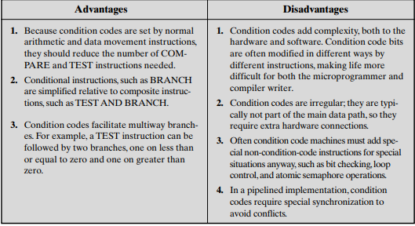
User-Visible Registers
A final category of registers, which is at least partially visible to the user, holds condition codes (also referred to as flags)
Condition code bits are collected into one or more registers. Usually, they form part of a control register. but the programmer cannot alter them.
Condition Codes

Slide 70
Control and Status Registers
Four registers are essential to instruction execution:
Program counter (PC)
■ Contains the address of an instruction to be fetched Instruction register (IR)
■ Contains the instruction most recently fetched
Memory address register (MAR)
■ Contains the address of a location in memory
Memory buffer register (MBR)
■ Contains a word of data to be written to memory or the word most recently read

Slide 71
Program Status Word
A set of bits
Includes Condition Codes
Sign of last result
Zero
Carry
Equal
Overflow
Interrupt enable/disable
Supervisor

Slide 72
Program Status Word (PSW)
Supervisor: Indicates whether the processor is executing in supervisor or user mode. Certain privileged instructions can be executed only in supervisor mode, and certain areas of memory can be accessed only in supervisor mode.
Intel ring zero Kernel mode
Other Registers
May have registers pointing to:
Process control blocks (see O/S)
Interrupt Vectors (see O/S)

Slide 73
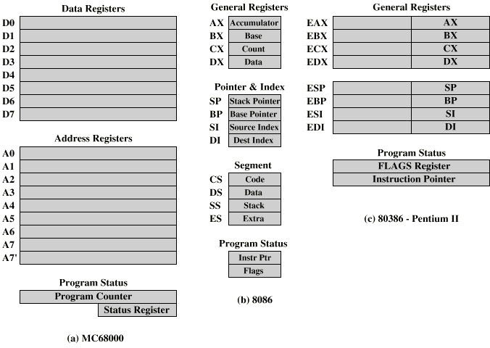
Example Register Organizations

Slide 74
Example Register Organizations
compare the register organization of comparable systems.
The MC68000 partitions its 32-bit registers into eight data registers and nine address registers.
The eight data registers are used primarily for data manipulation and are also used in addressing as index registers.
The width of the registers allows 8-, 16-, and 32-bit data operations, determined by opcode.
The address registers contain 32-bit (no segmentation) addresses; two of these registers are also used as stack pointers, one for users and one for the operating system, depending on the current execution mode.
Both registers are numbered 7, because only one can be used at a time. The MC68000 also includes a 32-bit program counter and a 16-bit status register.

Slide 75
Example Register Organizations
The Intel 8086 takes a different approach to register organization. Every register is special purpose, although some registers are also usable as general purpose. The 8086 contains four 16-bit data registers that are addressable on a byte or 16-bit basis, and four 16-bit pointer and index registers. The data registers can be used as general purpose in some instructions. In others, the registers are used implicitly. For example, a multiply instruction always uses the accumulator. The four pointer registers are also used implicitly in a number of operations; each contains a segment offset. There are also four 16-bit segment registers. Three of the four segment registers are used in a dedicated, implicit fashion, to point to the segment of the current instruction (useful for branch instructions), a segment containing data, and a segment containing a stack, respectively. These dedicated and implicit uses provide for compact encoding at the cost of reduced flexibility. The 8086 also includes an instruction pointer and a set of 1-bit status and control flags.

Slide 76
Example Register Organizations
A second instructive point concerning register organization design is illustrated in Figure c. This figure shows the user-visible register organization for the Intel 80386 , which is a 32-bit microprocessor designed as an extension of the 8086. The 80386 uses 32-bit registers. However, to provide upward compatibility for programs written on the earlier machine, the 80386 retains the original register organization embedded in the new organization. Given this design constraint, the architects of the 32-bit processors had limited flexibility in designing the register organization.
The point of this comparison should be clear. There is no universally accepted philosophy concerning the best way to organize processor registers.
As with overall instruction set design and so many other processor design issues, it is still a matter of judgment and taste.

Slide 77
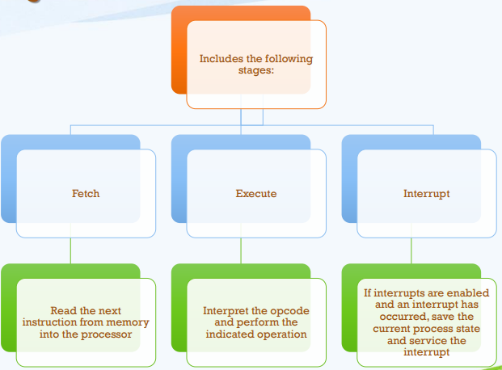
Instruction Cycle

Slide 78
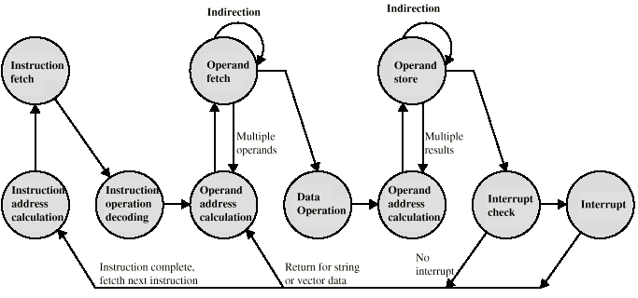
Instruction Cycle State Diagram
This illustrates more correctly the nature of the instruction cycle. Once an instruction is fetched, its operand specifiers must be identified. Each input operand in memory is then fetched, and this process may require indirect addressing. Register-based operands need not be fetched. Once the opcode is executed, a similar process may be needed to store the result in main memory.

